Slide 1
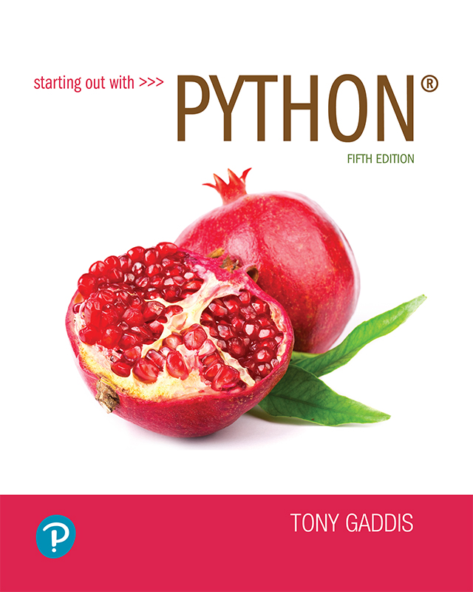
Starting out with Python
Fifth Edition
Chapter 4
Repetition Structures
Copyright © 2021, 2018, 2015 Pearson Education, Inc. All Rights Reserved

Slide 2
Topics
Introduction to Repetition Structures
The while Loop: a Condition-Controlled Loop
The for Loop: a Count-Controlled Loop
Calculating a Running Total
Sentinels
Input Validation Loops
Nested Loops
Turtle Graphics: Using Loops to Draw Designs

Slide 3
Introduction to Repetition Structures
Often have to write code that performs the same task multiple times
Disadvantages to duplicating code
Makes program large
Time consuming
May need to be corrected in many places
Repetition structure: makes computer repeat included code as necessary
Includes condition-controlled loops and count-controlled loops

Slide 4
The while Loop: a Condition-Controlled Loop (1 of 4)
while loop: while condition is true, do something
Two parts:
Condition tested for true or false value
Statements repeated as long as condition is true
In flow chart, line goes back to previous part
General format:
while condition:
statements

Slide 5
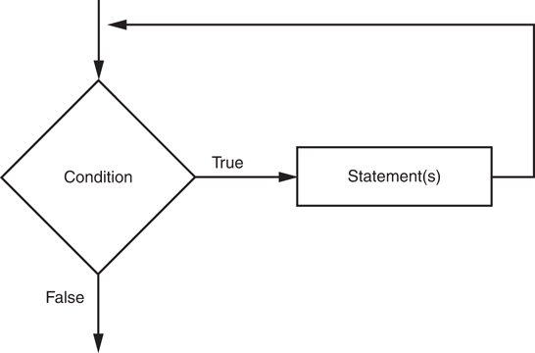
The while Loop: a Condition-Controlled Loop (2 of 4)
Figure 4-1 The logic of a while loop

Slide 6
The while Loop: a Condition-Controlled Loop (3 of 4)
In order for a loop to stop executing, something has to happen inside the loop to make the condition false
Iteration: one execution of the body of a loop
while loop is known as a pretest loop
Tests condition before performing an iteration
Will never execute if condition is false to start with
Requires performing some steps prior to the loop

Slide 7
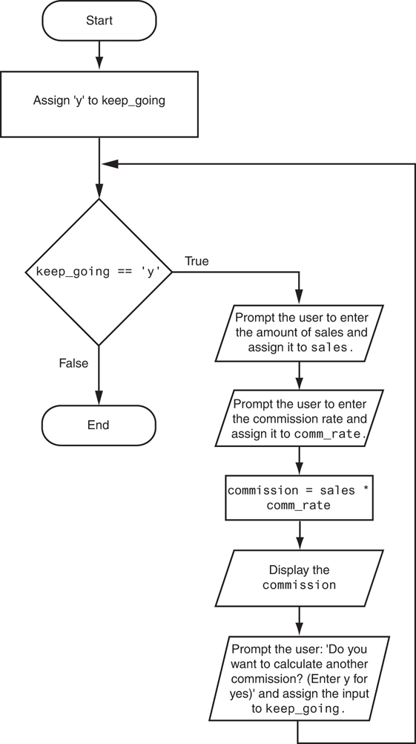
The while Loop: a Condition-Controlled Loop (4 of 4)
Figure 4-3 Flowchart for Program 4-1

Slide 8
Infinite Loops
Loops must contain within themselves a way to terminate
Something inside a while loop must eventually make the condition false
Infinite loop: loop that does not have a way of stopping
Repeats until program is interrupted
Occurs when programmer forgets to include stopping code in the loop

Slide 9
The for Loop: a Count-Controlled Loop (1 of 2)
Count-Controlled loop: iterates a specific number of times
Use a for statement to write count-controlled loop
Designed to work with sequence of data items
Iterates once for each item in the sequence
General format:
for variable in [val1, val2, etc]:
statements
Target variable: the variable which is the target of the assignment at the beginning of each iteration

Slide 10
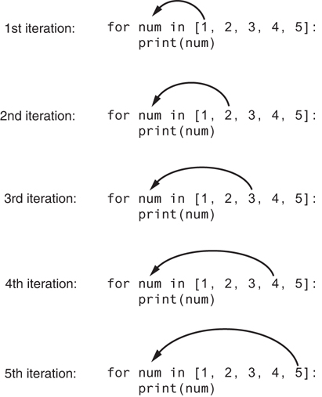
The for Loop: a Count-Controlled Loop (2 of 2)
Figure 4-4 The for loop

Slide 11
Using the range Function with the for Loop
The range function simplifies the process of writing a for loop
range returns an iterable object
Iterable: contains a sequence of values that can be iterated over
range characteristics:
One argument: used as ending limit
Two arguments: starting value and ending limit
Three arguments: third argument is step value

Slide 12
Using the Target Variable Inside the Loop
Purpose of target variable is to reference each item in a sequence as the loop iterates
Target variable can be used in calculations or tasks in the body of the loop
Example: calculate square root of each number in a range

Slide 13
Letting the User Control the Loop Iterations
Sometimes the programmer does not know exactly how many times the loop will execute
Can receive range inputs from the user, place them in variables, and call the range function in the for clause using these variables
Be sure to consider the end cases: range does not include the ending limit

Slide 14
Generating an Iterable Sequence that Ranges from Highest to Lowest
The range function can be used to generate a sequence with numbers in descending order
Make sure starting number is larger than end limit, and step value is negative
Example: range(10, 0, -1)

Slide 15
Calculating a Running Total (1 of 2)
Programs often need to calculate a total of a series of numbers
Typically include two elements:
A loop that reads each number in series
An accumulator variable
Known as program that keeps a running total: accumulates total and reads in series
At end of loop, accumulator will reference the total

Slide 16
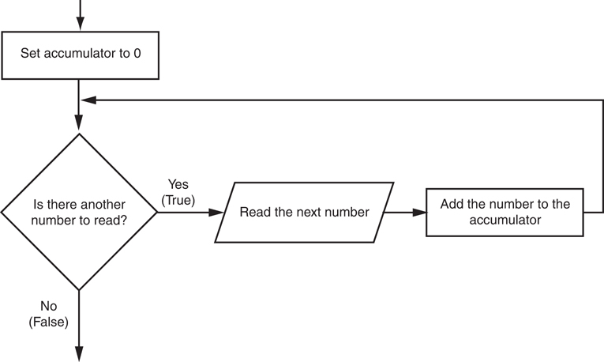
Calculating a Running Total (2 of 2)
Figure 4-6 Logic for calculating a running total

Slide 17
The Augmented Assignment Operators (1 of 2)
In many assignment statements, the variable on the left side of the = operator also appears on the right side of the = operator
Augmented assignment operators: special set of operators designed for this type of job
Shorthand operators

Slide 18
The Augmented Assignment Operators (2 of 2)
Table 4-2 Augmented assignment operators
Operator | Example Usage | Equivalent To
+= | x += 5 | x = x + 5
−= | y −= 2 | y = y − 2
*= | z *= 10 | z = z * 10
/= | a /= b | a = a / b
%= | c %= 3 | c = c % 3
//= | x //= 3 | x = x // 3
**= | y **= 2 | y = y**2

Slide 19
Sentinels
Sentinel: special value that marks the end of a sequence of items
When program reaches a sentinel, it knows that the end of the sequence of items was reached, and the loop terminates
Must be distinctive enough so as not to be mistaken for a regular value in the sequence
Example: when reading an input file, empty line can be used as a sentinel

Slide 20
Input Validation Loops (1 of 3)
Computer cannot tell the difference between good data and bad data
If user provides bad input, program will produce bad output
GIGO: garbage in, garbage out
It is important to design program such that bad input is never accepted

Slide 21
Input Validation Loops (2 of 3)
Input validation: inspecting input before it is processed by the program
If input is invalid, prompt user to enter correct data
Commonly accomplished using a while loop which repeats as long as the input is bad
If input is bad, display error message and receive another set of data
If input is good, continue to process the input

Slide 22
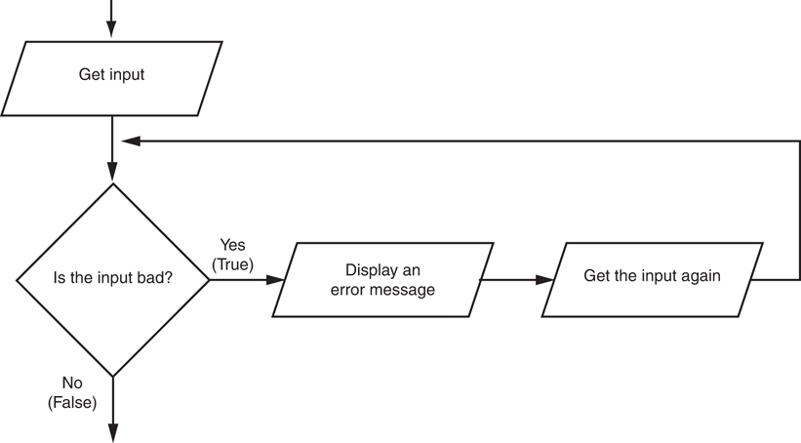
Input Validation Loops (3 of 3)
Figure 4-7 Logic containing an input validation loop

Slide 23
Nested Loops (1 of 3)
Nested loop: loop that is contained inside another loop
Example: analog clock works like a nested loop
Hours hand moves once for every twelve movements of the minutes hand: for each iteration of the “hours,” do twelve iterations of “minutes”
Seconds hand moves 60 times for each movement of the minutes hand: for each iteration of “minutes,” do 60 iterations of “seconds”

Slide 24
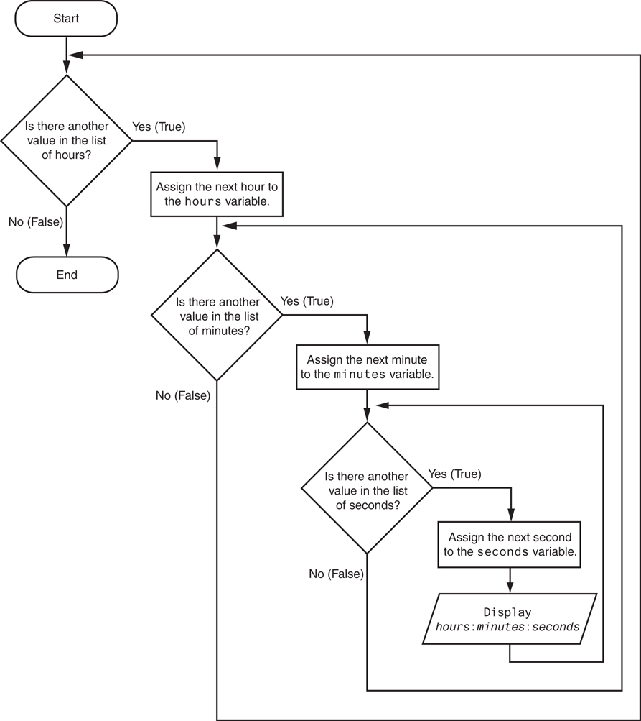
Nested Loops (2 of 3)
Figure 4-8 Flowchart for a clock simulator

Slide 25
Nested Loops (3 of 3)
Key points about nested loops:
Inner loop goes through all of its iterations for each iteration of outer loop
Inner loops complete their iterations faster than outer loops
Total number of iterations in nested loop:
number of iterations of inner loop X number of iterations of outer loop

Slide 26
Turtle Graphics: Using Loops to Draw Designs (1 of 4)
You can use loops with the turtle to draw both simple shapes and elaborate designs. For example, the following for loop iterates four times to draw a square that is 100 pixels wide:
for x in range(4):
turtle.forward(100)
turtle.right(90)

Slide 27
Turtle Graphics: Using Loops to Draw Designs (2 of 4)
This for loop iterates eight times to draw the octagon:
for x in range(8):
turtle.forward(100)
turtle.right(45)

Slide 28
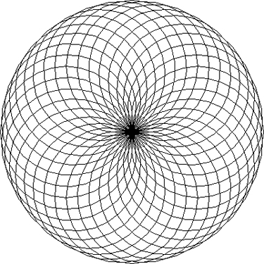
Turtle Graphics: Using Loops to Draw Designs (3 of 4)
You can create interesting designs by repeatedly drawing a simple shape, with the turtle tilted at a slightly different angle each time it draws the shape.
NUM_CIRCLES = 36 # Number of circles to draw
RADIUS = 100 # Radius of each circle
ANGLE = 10 # Angle to turn
for x in range(NUM_CIRCLES):
turtle.circle(RADIUS)
turtle.left(ANGLE)

Slide 29
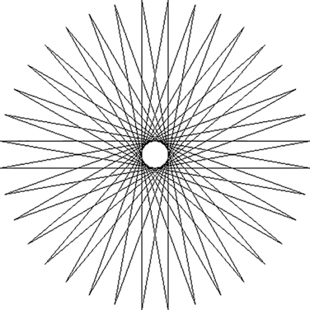
Turtle Graphics: Using Loops to Draw Designs (4 of 4)
This code draws a sequence of 36 straight lines to make a "starburst" design.
START_X = -200 # Starting X coordinate
START_Y = 0 # Starting Y coordinate
NUM_LINES = 36 # Number of lines to draw
LINE_LENGTH = 400 # Length of each line
ANGLE = 170 # Angle to turn
turtle.hideturtle()
turtle.penup()
turtle.goto(START_X, START_Y)
turtle.pendown()
for x in range(NUM_LINES):
turtle.forward(LINE_LENGTH)
turtle.left(ANGLE)

Slide 30
Summary
This chapter covered:
Repetition structures, including:
Condition-controlled loops
Count-controlled loops
Nested loops
Infinite loops and how they can be avoided
range function as used in for loops
Calculating a running total and augmented assignment operators
Use of sentinels to terminate loops
Using loops to draw turtle graphic designs

